Slide 1
Solve!

Slide 2
Objectives
To refresh your knowledge of what problem solving is all about
To show how to apply the problem solving process of Solve!
To apply the Solve!

Slide 3
First things first....
What is a problem?
A deviation from an acceptable performance
It is detected when there is a gap between what is happening and what should be happening
What is problem solving?
Isolation and analysis of the problem and development of a permanent solution to close the performance gap
Problem Solving = Zap the Gaps!

Slide 4
Problem solving: Common ineffective practices
Stopping too soon in the analysis of causes I know what the causes are, we don’t need to analyze them…
Placing the blame Someone is guilty…
The single root cause myth This is “the” root cause…
The illusion of common sense, single reality Not 2 people see the problem and its causes in the same way…
Storytelling ignoring causes and jumping to solutions…

Slide 5
Causes of ineffective problem solving
Incomplete problem definition
Unknown cause and effect relationships
Focus on solutions
No follow-up of action plans to solve the problem

Slide 6
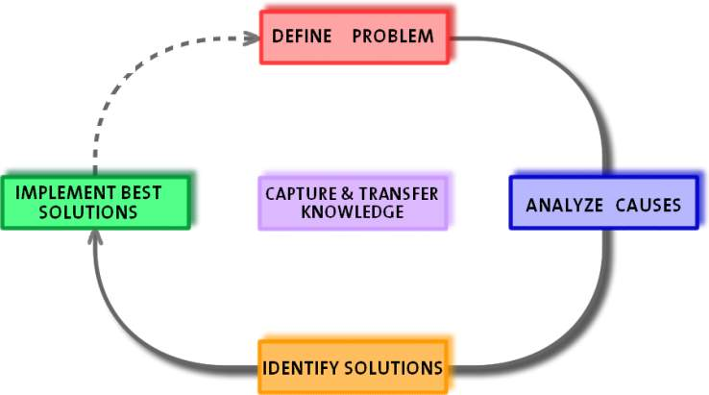
Holcim Systematic Problem Solving process
Should
G A P
Actual

Slide 7
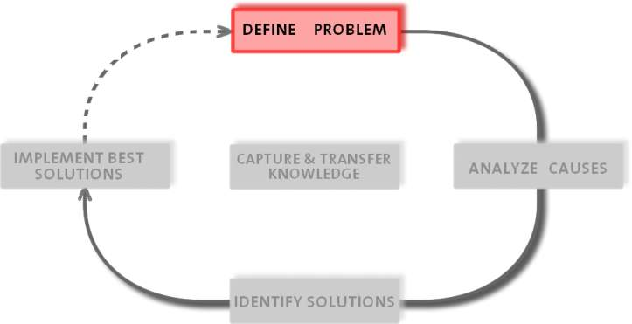
Solve! – Define the problem
“A problem well defined is a problem half solved”
Charles Kettering,

Slide 8
How to make a complete problem definition
Gather symptoms, observations, information, identify key people to solve the problem
Get all required members together
Ask members to describe the problem, discuss all problem statements
Agree on what the real problem is
Answer the following questions (3W 1H)
What?
When?
Where?
How much?

Slide 9
Meaning of the questions
What - Identity
What is the deviation (problem)? What effect/event we don’t want to happen again?
Where - Location
Where is the deviation (problem)? Place/area
When - Timing
When did the deviation (problem) happen? Chronological/relative time
How much - Significance
How much is the deviation (the problem)? Describe your gap and objective, understand its impact (safety, environment, loss of revenue, cost, frequency)

Slide 10
Solve! Example – Problem definition
What? Breakage of the separator main shaft
Where? Separator of the Vertical roller mill RM 361-SR1
When? 13.09.2012 @ 21:05
How much? ~3800 t of clinker production lost, 48 hours overtime

Slide 11
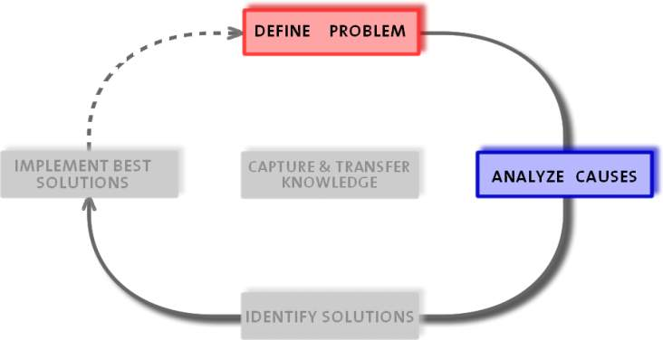
Solve! – Determine root causes
“Things do not just happen, they are made to happen.” John F. Kennedy

Slide 12
Difference between symptoms and causes
The need is to identify root causes – not symptoms
A root cause is a factor against which solutions can be applied
When these solutions are implemented, the cause will be eliminated and/or its effects minimized
A symptom is a sign or indication of a root cause but is, by itself, not the cause
Generally it is difficult to identify solutions for a symptom, as the symptom lacks specificity
This will lead to “solution-guessing” that may or may not have the desired impact

Slide 13
Difference between symptoms and causes
Symptom
Problem
Cause
“Oil leaking in the cylinder side of the roller press, eventually the hydraulic pump could not reach its operational pressure”
“Failure of the hydraulic system from the roller press in the cement area in June 2006 that resulted in 40 hours of loss production”
“Failure of the hydraulic system from the roller press in the cement area in June 2006 that resulted in 40 hours of loss production, because of contamination of the seals inside the cylinder or …”

Slide 14
Solve! Example – Possible root causes
Poor welding quality
Loose flange bolts
Vibration
Misbalance
Separator lower bearing casing misalignment
Poor shaft material
Manufacturing defect
Design error

Slide 15
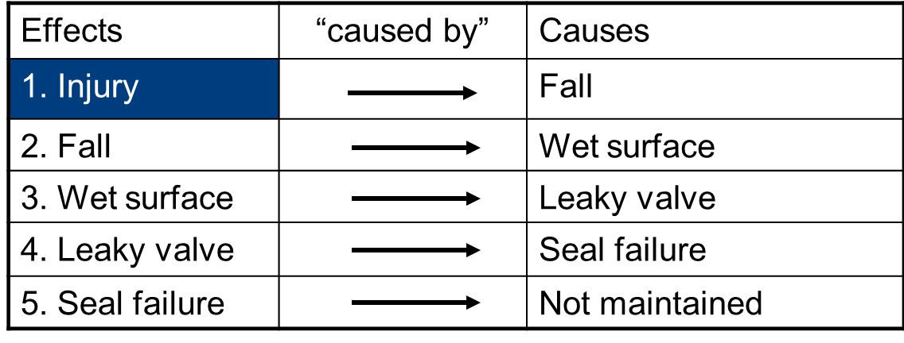
Characteristics of cause and effect
The four key characteristics
Cause and effect are the same thing
Cause & Effect are part of a continuum of causes
CB
CB
CB
CB
1
2
3
4
5
CB = Caused by
Notes:
Actions and Conditions:
➔ Each effect has at least two causes in the form of actions and conditions.
➔ Actions are momentary causes that bring conditions together to cause an effect.
➔ Conditions are causes that exist over time.
There is always at least one action, but there could be many conditions.
Cause and Effect Principle:
➔ Causes and effects are the same thing.
➔ There can be an infinite number of causes and effects.
➔ The primary effect is what we want to prevent from occurring.
An effect exists only if it’s cause exists at the same point in time and space.

Slide 16
Creating a Cause and Effect chart
Each effect has at least 2 causes in form of actions or conditions
An effect exists only if its causes exist at the same point in time and space
Match strike
Action
Ignition source
Fire
Condition
Combustible material
Condition
Oxygen
Condition

Slide 17
Creating a Cause and Effect chart
Creating a Cause and Effect chart has four steps:
For each effect ask “why (1W)?”
Connect all causes with “caused by”
Support causes with evidence
Test the strength of causal links
Keep going until:
It doesn’t add value to the analysis
You don’t know the answer and you need a lot of effort to answer it (ignorance point marked with “?”)
I can’t influence (it fell because of gravity; why is there gravity?)

Slide 18
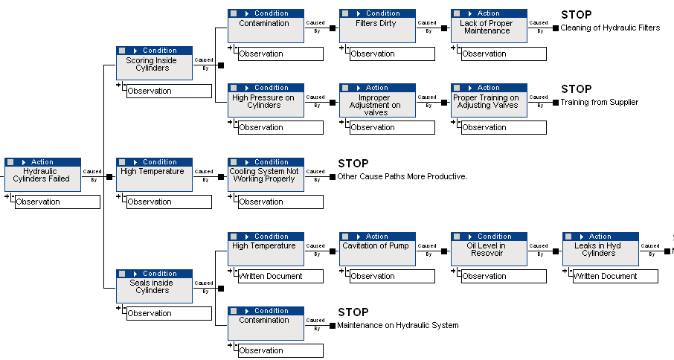
Creating a Cause and Effect chart: example

Slide 19
Solve! Example – Cause and effect diagram
The root cause of the shaft breakage is loose of flange bolts. Due to this reason shaft was broken from the flange connection.
It happened due to lack of inspection during stoppage.

Slide 20
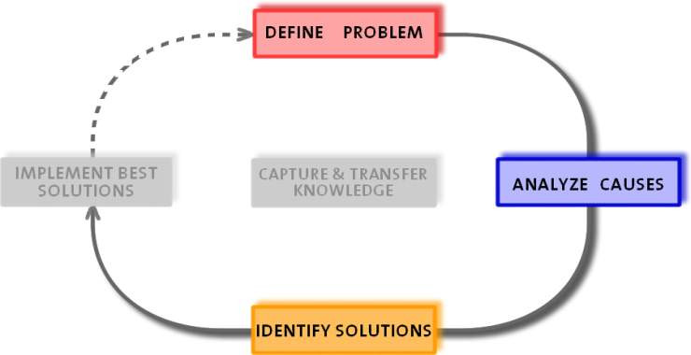
Solve! – Select the right solution
“It is the solution that makes the problem go away, not the root cause” Dean L. Gano
Notes:
Dean L. Gano created the Apollo Method for Root Cause Analysis

Slide 21
What is a solution?
A solution is …
… a specific action taken upon a cause to affect a desired condition. Generally the action is to remove a cause or if not possible to remove it then to control the cause.
A good solution must meet the following criteria:
Prevent recurrence and similar problems
Be within the control of you, your department, company, suppliers or customers
Meet goals and objectives of the organization and be reasonable
Notes:
A solution
There are an infinite number of causes connected in many ways, so an infinite number of possible solutions exist. We simply need to affect one cause in a chain such that the problem does not occur. There are no rules that govern the location of this cause. It does not have to be at the end of a chain as the notion of root cause would have us believe. Indeed the best solution may be to remove the very first cause (primary effect). For example, for some people the best solution to human error would be to eliminate all employees.
The desired condition or outcome is the focal point of any solution. For problems that have already occurred, a primary goal is to prevent recurrence
Solutions must be within our control. It is a common tendency to identify solutions that require other people to act.
Solutions should always be specific actions. It makes no sense to attack a specific problem with non-specific solutions. If the problem was “no money”, the solution shouldn’t be “get some”. Do not include solutions such as review, analyse, or investigate.
Good solution
In the course of identifying solutions, often some solutions do not meet all three criteria but still provide value. We may choose to implement them and this is acceptable, but make sure to identify which cause it attacks. Also, identify these solutions for what they are. If they are not required to prevent recurrence, but will improve the situation, then make this clear. Sometimes we include pet peeve solutions into an inappropriate problem, which results in spending money on something that does not prevent recurrence.
Never get into an argument about who is right and who is wrong. There is no such thing in the world of events; the solutions are only good, better or best. We never have enough information to totally understand anything we do; we can only operate on what we know. If it is documented on a cause and effect chart, at least, we have a form of communication that allows for everyone’s understanding to be represented.
Obtaining this common reality is the key to effective problem solving, communication, and buy-in from all stakeholders.

Slide 22
Solution finding techniques
The following techniques can be used to find solutions:
1 Brainstorming
2 TPN Analysis
3 Matrix Analysis
Best solutions

Slide 23
Solution finding techniques
Brainstorming
Why use brainstorming?
The main value of brainstorming is that it involves everyone and sparks creativity
Rules for brainstorming
Involve everyone
Allow everybody to contribute
No discussion / criticism / evaluation
Capture everything in a visible format
Number the ideas as they emerge
Go into a free flow mode towards the end
Notes:
Examples for brainstorming as a flip-chart exercise:
I. I’m pursuing my career – what do I need to take into account?
Work for established organisation
Family needs and happiness
Career of partner
Job has to be fun
Obtain further qualification
Continuos learning
Job needs to stretch my abilities
What are future employment trends
Eventually less pay for “right” job
___________________________________________________
II. What are the requirements for a car in the year 2010?
Low fuel consumption
Powerful engine
etc.

Slide 24
Solution finding techniques
TPN analysis
TPN analysis - the method
Take the numbered list from the brainstorming session
For each item on the list, decide whether your span of control over it is
T - Total
P - Partial
N - None
This forces the group to look only at the solutions where they can have an impact
Notes:
Referring to example 1 of the brainstorming part (proceed flip chart exercise):
Which of these points can I influence myself and which not?
Work for established organisation T
Family needs and happiness P
Career of partner P
Job has to be fun P
Obtain further qualification P
Continuos learning T
Job needs to stretch my abilities P
What are future employment trends N
Eventually less pay for “right” job T

Slide 25
Solution finding techniques
Matrix analysis
Take the suggested solutions which have emerged from the TPN analysis where you have decided that you have total or partial control
Define criteria to evaluate the solutions
Impact on the issue (e.g. productivity, cost, etc.)
Ease of implementation (cost, time, resources, etc.)
Prepare a matrix constructed with the criteria as the axes, and analyze solutions against those criteria
Identify the key priority issues according to the criteria chosen
Notes:
The issues that have emerged from the TPN Analysis where I have total control are the following:
Work for established organisation T
Continuos learning T
Eventually less pay for “right” job T
As a next step these three issues are placed in the matrix (see next page):
The impact on my career of working for an established organisation (point 1) si considered as low and the ease of implementation as well (bad economical situation)
The impact of continuos learning (point 2) on my career is considered as high and the ease of implementation as well, since many institute offer courses and many companies offer trainings
The fact that I get less payed doesn’t necessarily have a positive impact on my career, but of course it’s easy to get a bad payed job
> Try to concentrate on point 2 “continuos learning”

Slide 26
Solution finding technique
Matrix analysis
Failure of the roller press hydraulic system
Easy
Daily shift inspection
of hyd syst. parameters
(operation)
Get technical
training from supplier
Install smaller
micron oil filter
Add Desiccant
breather to
hydraulic tank
Install oil level sensor
and temp. interlock
to control room
6M PMR
to calibrate
hyd. system
Proper management
of oil and filtration
systems
Ease of Implementation
Install higher capacity
Oil cooler, high temp interlock
and valve adjustment
Replacement of seals from both cylinders
Change roller
Hard
Low
High
Impact
Notes:
After having placed the issues the matrix looks the following:
Hard
Solution to implement
1
2
3

Slide 27
Testing and evaluation
Testing and evaluating the solution is a trial to see if the solution actually solves the identified problem
The process may occur throughout other steps in the process to determine if individual parts or subsystems of the solution work
An important component is the risk determination
For solutions of bigger extend, risk assessment is a must
For straight forward actions, risk assessment is optional

Slide 28
Tips and tricks
Search for previous solutions to similar problems to avoid reinventing the wheel
Start finding solutions to the root cause
If you can‘t tackle the root causes, try to tackle intermediate effects in the chain
Make no judgments about possible solutions when brainstorming, propose “unconventional“ solutions
Be open to creative ideas
Evaluation of solutions is a cost/benefit analysis of all the alternatives. Be consistent in the evaluation, consider also the risks

Slide 29
Tips and tricks
In the process of solution finding several different techniques, e.g. brainstorming can be used
Involve the stakeholders in the process of selecting the solution
Check if your solution fulfills the following criteria:
Prevent recurrence
Be within your control
Meet your goals and objectives
Sometimes the wrong solution is worse than no solution. Select the right solutions!

Slide 30
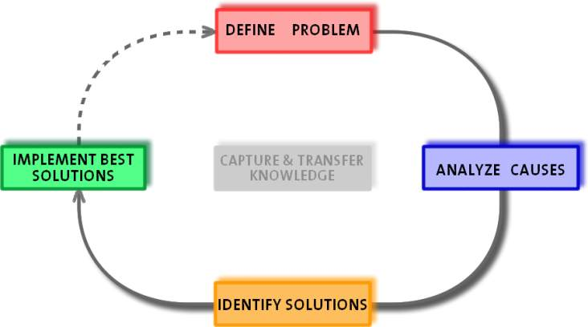
Solve! - Implement the best solution
“It is a funny thing about life: if you refuse to accept anything but the very best, you very often get it.” Somerset Maugham
Notes:
William Somerset Maugham (1874 – 1965) British Novelist

Slide 31
Implementing a solution
The implementation must be planned according to the “Plan, Do, Check, Act” cycle
Plan
Plan the implementation and define the metrics
Do
Start the implementation process
Check
Check the implementation results against target
Act
If the implementation results are off target then act immediately to realign

